Slide 1
Model Solar System
Matt Siragusa, Jeremy Eckstrom, Mike Weinheimer

Slide 2
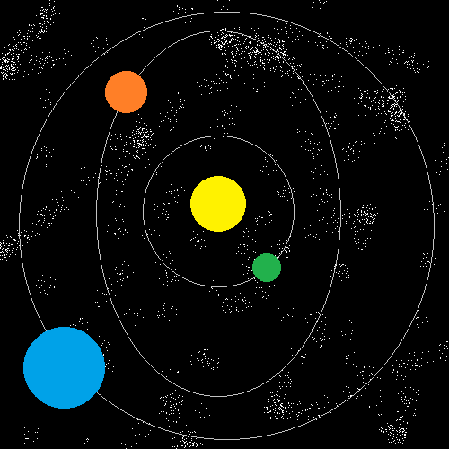
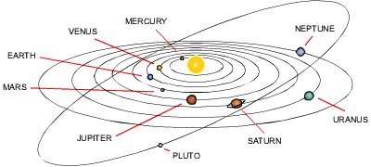
Basic Concept
Create a basic solar system model
Not necessarily our solar system
3D spheres revolving around a sun
Orbitals showing the path of the planets

Slide 3
Desired Components
The planets will be able to revolve around a center location, as well as rotate on an axis
The user will be able to pause and fast forward the simulation
The camera will revolve around the solar system in order to get different views of it
The ability to select planets and display information about each one

Slide 4
Current Components
The planets are modeled as 3D Spheres
gluSphere()
The planets revolve around the sun sphere which remains stationary
Lighting originating from the sun creates shadows on passing planets
Camera movement allows for viewing of the system in all directions

Slide 5
Timeline
By Nov 1st
Have the planets and their orbits implemented
By Nov 28th
Have the planets shaded and the camera functionality implemented
By Dec 13th
All functionality should be done

Slide 6
Problems faced
Hard time texturing spheres
Libraries deprecated
Sun lighting scheme difficult
Some time was spent getting sphere revolution correct

Slide 7
Demo

Slide 8
Questions?

